Slide 1
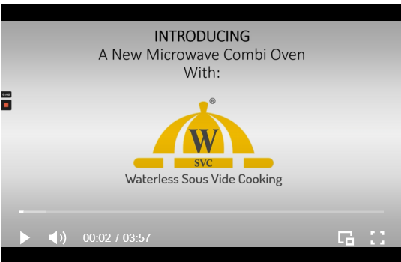
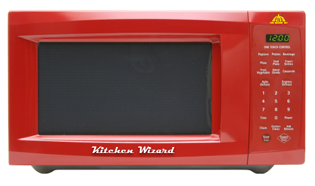
INTRODUCING:
A New Microwave Combi Oven With WSVC
What is Waterless Sous Vide Cooking?
WSVC is an appliance company that has invented a new type of multi-purpose microwave oven that features traditional microwave cooking as well as Waterless Sous Vide Cooking (WSVC).
WSVC cooks food with low consistent heat similar to sous vide but without the water bath and vacuum seal.
Presentation and Demo video
Countertop version
Pre-Production demos available in December 2021
Production units available in Q2’22
MSRP: $350
Contact Info: Sandy Goldman sandy@thebrandliaison.com 1-561-213-0299

